Slide 1
PROJECT TITLE
CAPSTONE PROJECT
Presented By: Bavishyath
Student Name : K R Bavishyath
College Name & Department : SRMIST Dep (NWC)

Slide 2
OUTLINE
Problem Statement
Technology used
Wow factor
End users
Result
Conclusion
Git-hub Link
Future scope

Slide 3
PROBLEM STATEMENT
Traditional encryption methods make encrypted messages visually obvious, raising suspicion.
Digital communication requires a hidden, secure way to transmit sensitive data.
Steganography provides a solution by embedding secret messages inside images without altering their visible appearance.
A robust technique is needed to ensure only authorized users can retrieve the hidden message.
This project implements pixel-based message encoding, leveraging image properties for encryption.
Ensuring privacy and security, the approach makes hidden messages undetectable to unauthorized users.

Slide 4
TECHNOLOGY USED
Programming Language: Python
Libraries Used:
OpenCV (cv2) – Image processing
OS module – File handling
String module – Text encoding
,

Slide 5
WOW FACTORS
Invisible Encryption: Messages are hidden inside images without altering their appearance.
Passcode-Protected Security: Only users with the correct passcode can decrypt the message.
No Extra Files Required: No need for separate encrypted files—message is embedded in the image itself.
Lightweight & Fast: Uses minimal computing power for encryption/decryption.
Can Be Used in Cybersecurity: Helps in secure communication and data protection.

Slide 6
END USERS
Security Enthusiasts – Learning & testing encryption techniques.
Cybersecurity Professionals – Protecting sensitive data.
Government & Intelligence Agencies – Confidential communication.
Journalists & Activists – Hiding sensitive reports and sources.
Corporate Companies – Secure internal communications.
General Users – Anyone who needs a private and secure messaging system.

Slide 7
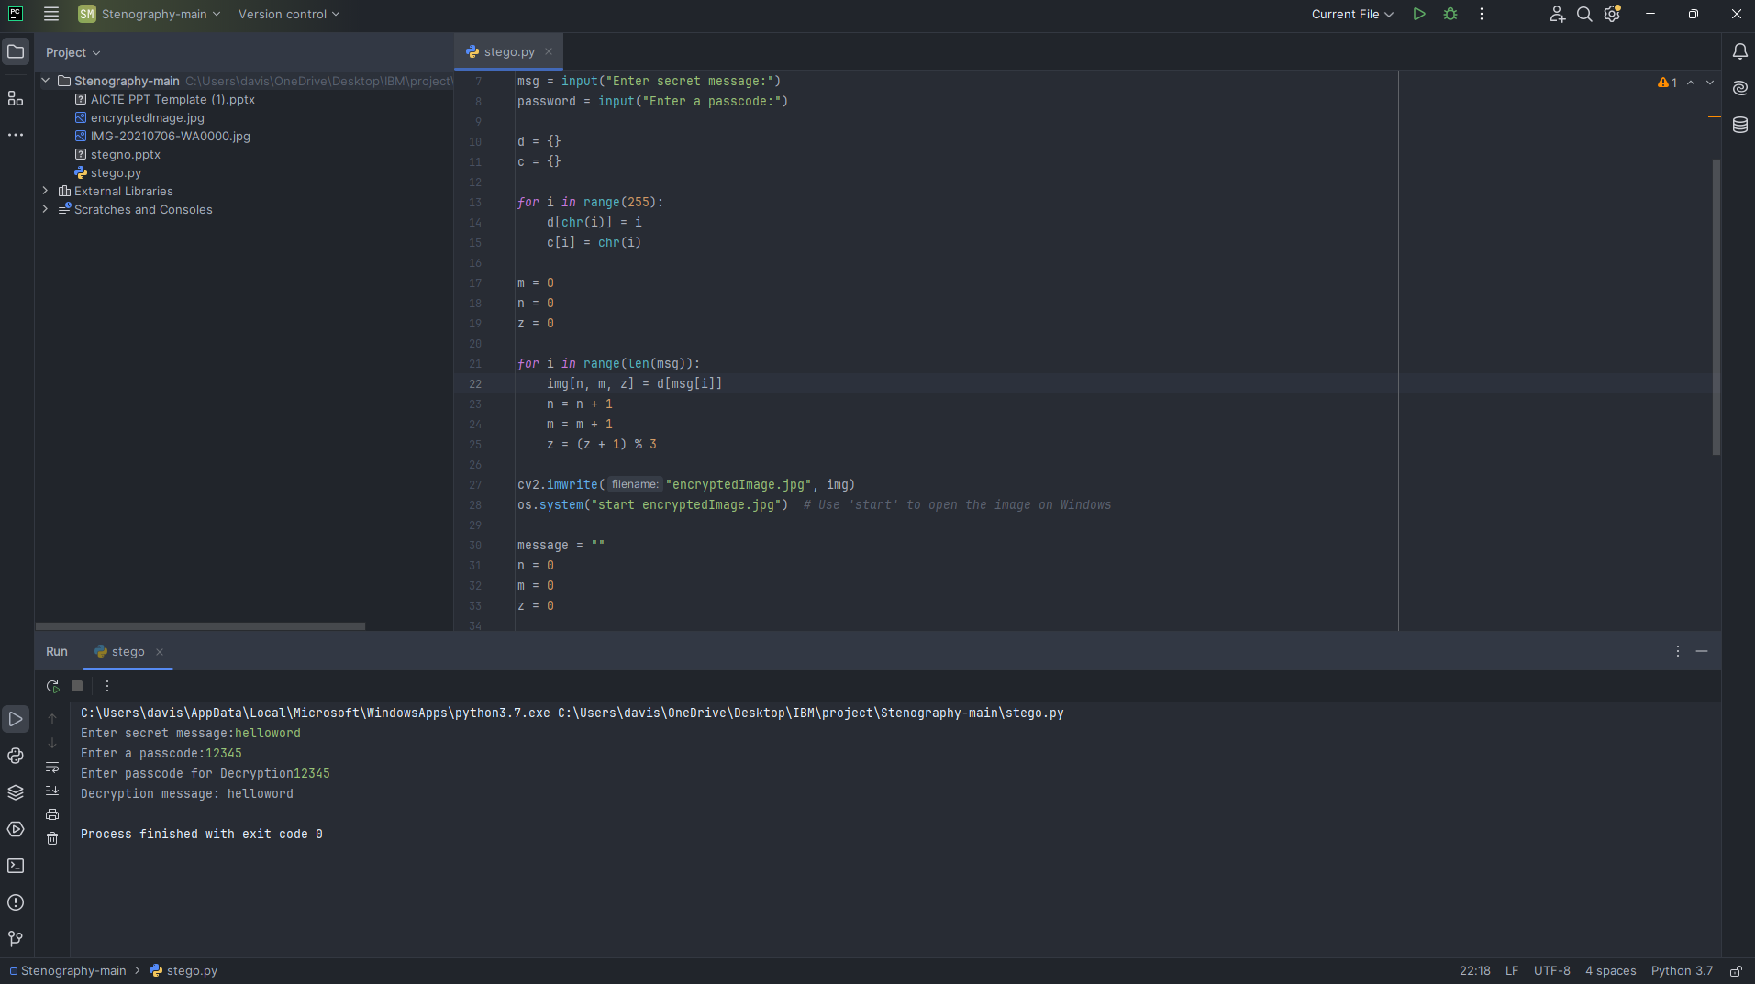
RESULTS

Slide 8
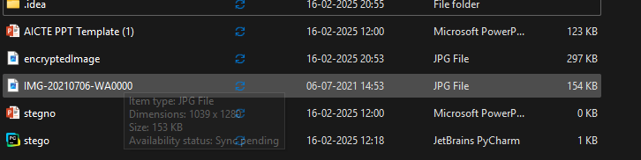

Slide 9
CONCLUSION
Successfully implemented image-based encryption using steganography.
Provides a secure and undetectable method for transmitting private messages.
The passcode feature ensures only authorized users can access the hidden data.
Practical for cybersecurity, secure communication, and data protection.
Future improvements can enhance security and efficiency.

Slide 10
GITHUB LINK
https://github.com/Bavishyath/Steganography.git

Slide 11
FUTURE SCOPE(OPTIONAL)
Advanced Security: Use encryption algorithms like AES along with steganography.
Multi-File Format Support: Extend support to PNG, BMP, and other lossless formats.
Graphical User Interface (GUI): Create a user-friendly interface for easier access.
AI-Based Optimization: Improve message hiding efficiency using AI-driven methods.
Cloud Integration: Secure online steganography tool for global access.

Slide 12
THANK YOU

